Slide 1

Data Story Final Project
By-
Dhruv Tewari

Slide 2
Problem Statement
What are the 3 characteristics difference between the top 10% and rest of the movies released in terms of revenue generated?

Slide 3
Issue Tree
What are the 3 characteristics difference between the top 10% and rest of the movies released in terms of revenue generated?
Does the audience demographic has any effect on the movies revenue?
Does the time when the movie has released has any effect on the revenue?
Does the banner or production house affects the performance of the movie?
Age Group
Location
Household Income
Month
Season
Holidays Season
Budget
Production

Slide 4
Ghost Deck
Synthesis:
The budget of the movie influence the revenue
Also production house also affect the revenue.
Overview of Analysis:
1- Does audience age affect revenue?
2- Does Location affect revenue?
3- Does release month or holiday season affect revenue
Location Difference:
Check if the location where the movies are released influence revenue.
Month of Release:
Calculate the month from the release date to compare it with total revenue generated
Season of Release:
Calculate the revenue generated by films according to the season
Production house:
Check the relationship between the budget and revenue of the movie released.
Limitation:
The dataset for the analysis is huge and has lot of messy data which can influence our final results outcome.
Review of the next steps:
Bring the race and age group population data of particular region to check the genre of the high revenue movies

Slide 5
Executive Summary
The 3 characteristics difference between the top 10% and rest of the movies released in terms of revenue generated are :
The Genre of the movie
The month of the release of the movie
We have also seen that the run-time of the movie also influenced the revenue generated.
Our recommendation, would be to produce an Action movie, with run-time in the range of 100 – 150 mins, and release it during the month of May, June or December to gain maximum revenue.

Slide 6
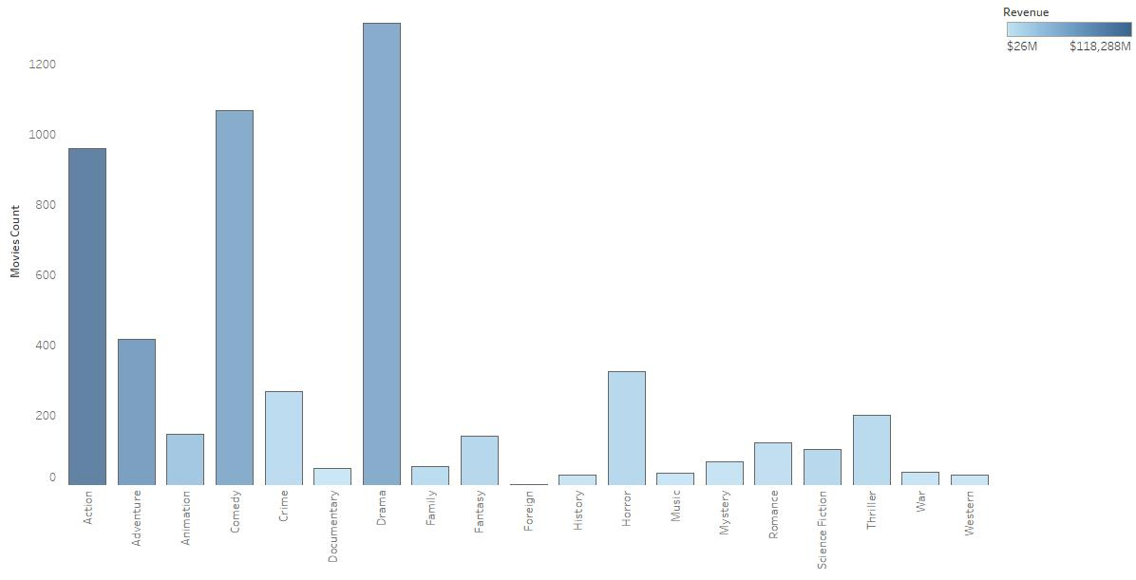
Overview of Analysis
1. Does Genre of the movie influence the revenue?
From the chart we can see that even though the count of production of Drama and Comedy genre is high that Action film, but revenue generated by Action films is the highest.

Slide 7
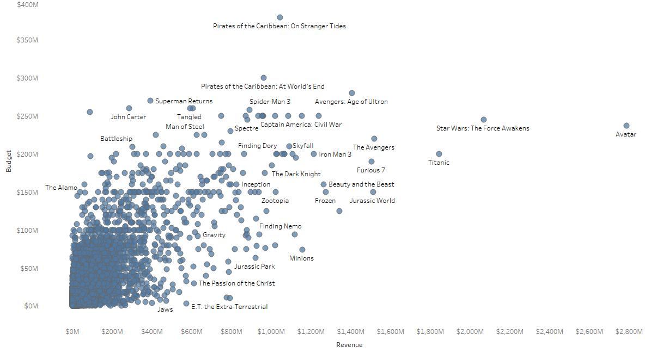
Overview of Analysis
2. Does Budget and Revenue are co-related with each other?
From the scatter plot generated from the data we can see the positive linear relation ship between Budget and Revenue.
We also can see there few outliers films like Avatar, Pirates of Caribbean.

Slide 8
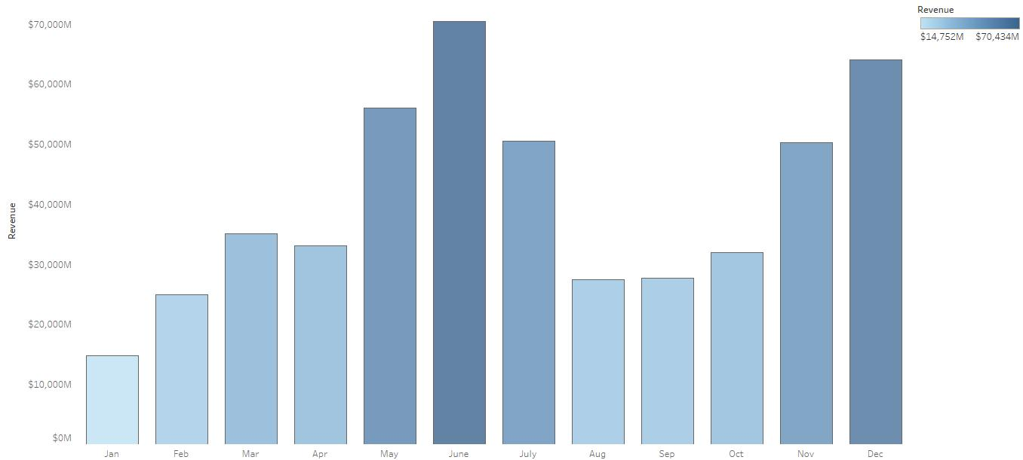
Overview of Analysis
3. Does the time when movie is release have some effect on the revenue?
From the chart we can see the most of revenues are generated by the films which are released on the during June, December and May month of the year.

Slide 9
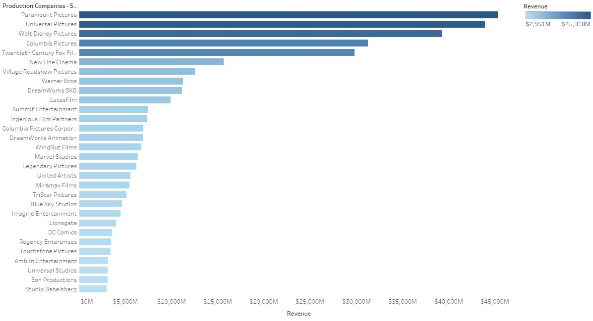
Overview of Analysis
3. Effect of the production house in the revenue generation?
From the graph we can conclude that large production houses like Warner, Pixar, Universal create more revenue that other production houses.
Maybe, this is because of the fact that the have higher budget for the production.

Slide 10
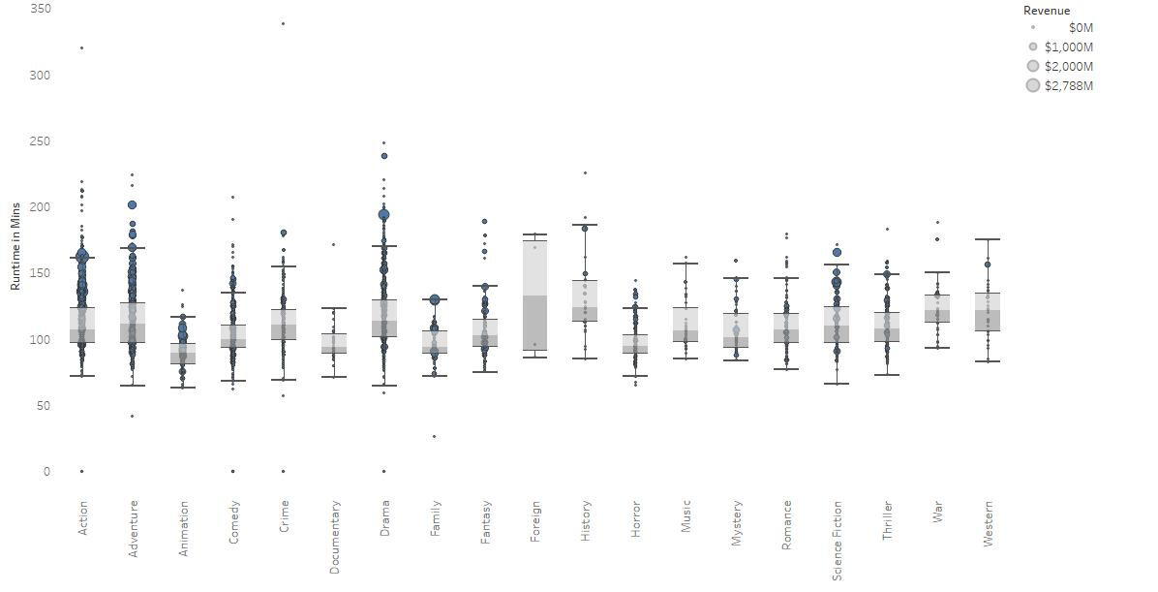
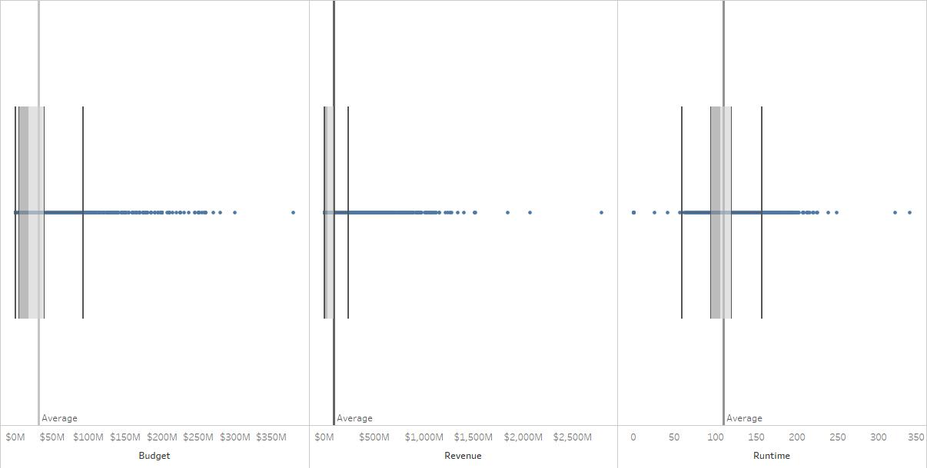
Outliers
From the below box plots gives us the outliers in terms of run-time, genre and revenue generated by the movies.
We can see here generally movies of long duration generated less revenue.

Slide 11
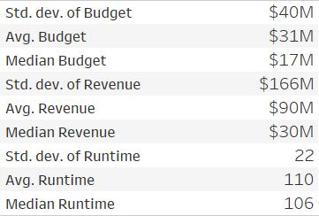
Summary Statistics

Slide 12
Limitation and Biases
Data Collection Biases:
The field Genre and Production Companies have dirty data field which may have influenced the analysis.
Data Processing Biases:
There are outliers for the Revenue variable which can make result inaccurate.
Data Insights Biases:
Most of the big production houses have big budget and hence has more revenue generated.

Slide 13
Thank you!

